Slide 1
CIS Foundations of Machine Learning
Chapter 6
Linear and Logistic Regression

Slide 2
Outline
Linear Regression
Mean Square Error
Cost Function
R-squares
Train/test Split
K-fold cross validation
Polynomial Regression
Bias vs Variance
Common Problems
Logistics Regression
Classification Problem
Maximum Likelihood Principle
Cost Function
Precision/Recall as Performance metric
Multi-Class Classification Problem

Slide 3
Linear Regression Model
The “Hello World Program” in Model Building

Slide 4
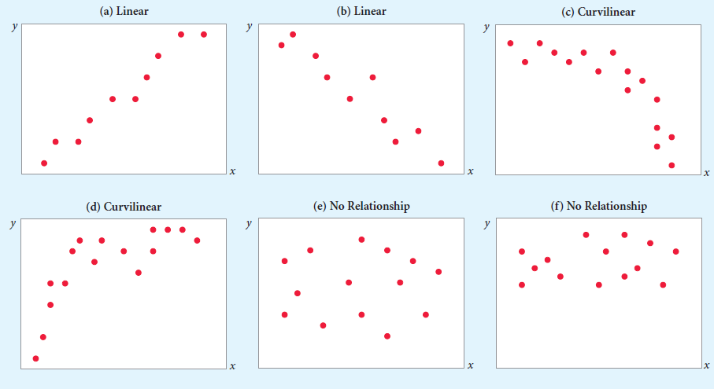
Relationships between variables

Slide 5
First Example: Predicting House Price
Observation:
House Price has a very high correlation with the size of the house (in square feet)
Call House Price as Y, Square feet of the house as X

Slide 6
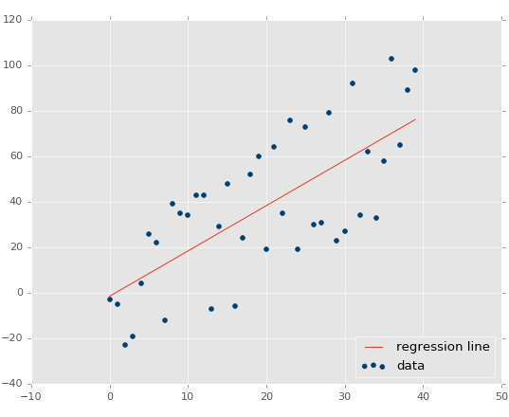
When the data shows linear relationship
Scatter plots of house price versus square feet display a linear relationship
First model come to mind is
Y = m X + b
But still, there can be many lines that can “kind of” fit the data as well
Question: How to pick the “best-fit” line?
Which line, blue or red fits the data better?

Slide 7
Outline
Linear Regression
Mean Square Error
Cost Function
R-squares
Train/test Split
K-fold cross validation
Lessons learned from Polynomial Regression
Logistics Regression
Classification Problem
Maximum Likelihood Principle
Cost Function
Precision/Recall as Performance metric

Slide 8
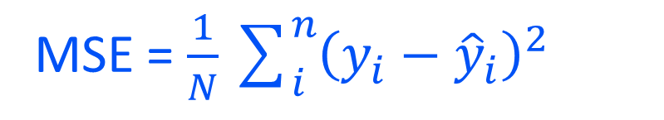
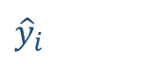
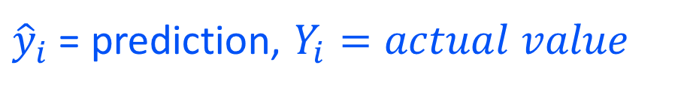


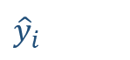
How to find the best fitting line?
Define Mean Squared Error (MSE)
To be the square of the distance between actual and predict Y values
${\hat{y}}_{i}$ = prediction, $Y_{i}=actual value$
MSE = $\frac{1}{N}\sum_{i}^{n}{{\left(y_{i}−{\hat{y}}_{i}\right)}^{2}}$
$$Y_{i}$$
${\hat{y}}_{i}$
Best fitted line is the line that minimize the MSE =>
Least Square Methods
${\hat{y}}_{i}$
$$Y_{i}$$

Slide 9
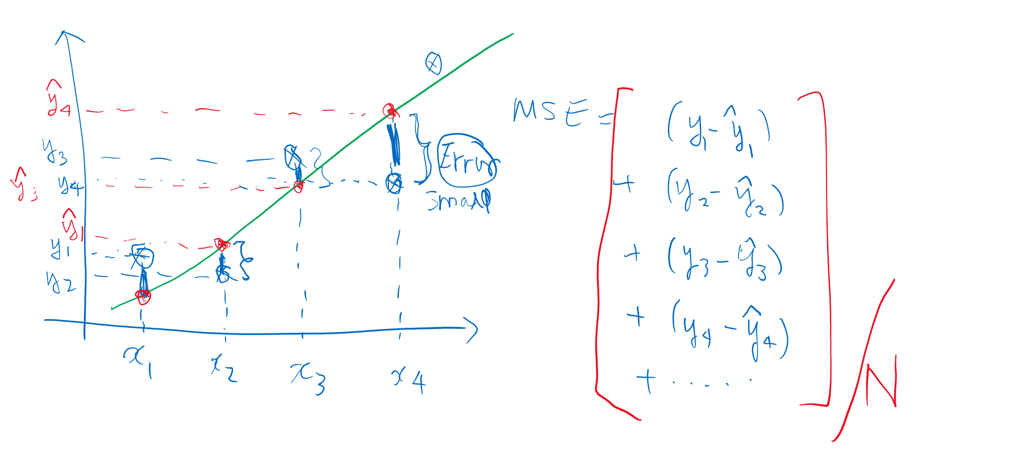
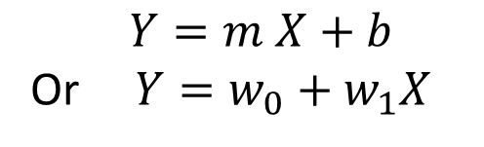
Calculating MSE
$Y=m X+b$
Or $Y=w_{0}+w_{1}X$
<= One-factor model
The index i in $x_{i} refers to the$i-th data points

Slide 10
N-factors Linear Model
House has more factors (aka features) than “square feet” that can affect the value of the house
X₁ | X₂ | X₃ | … | ^{X}D-1 | X_{D} | Y
0.23 | 0.79 | 0.33 | … | -2.4 | 0.91 | 4.5
 |  |  | … |  |  | …
-0.34 | 0.44 | -0.32 | … | 0.11 | 0.007 | 3.7
0.40 | -0.68 | 0.82 | … | -0.45 | 0.004 | -4.3

Slide 11
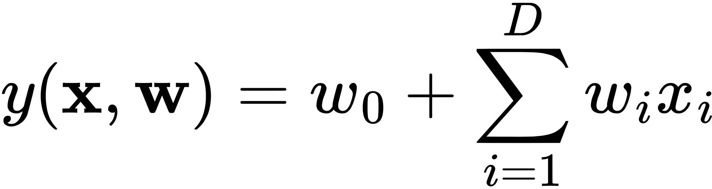
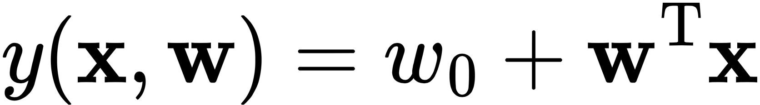
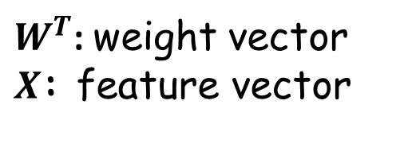
Linear Regression
called “offset” or “bias”, or “intercept”
the importance (i.e., “weight” or “coefficient”) of each feature
$W^{T}$: weight vector
$X$: feature vector

Slide 12
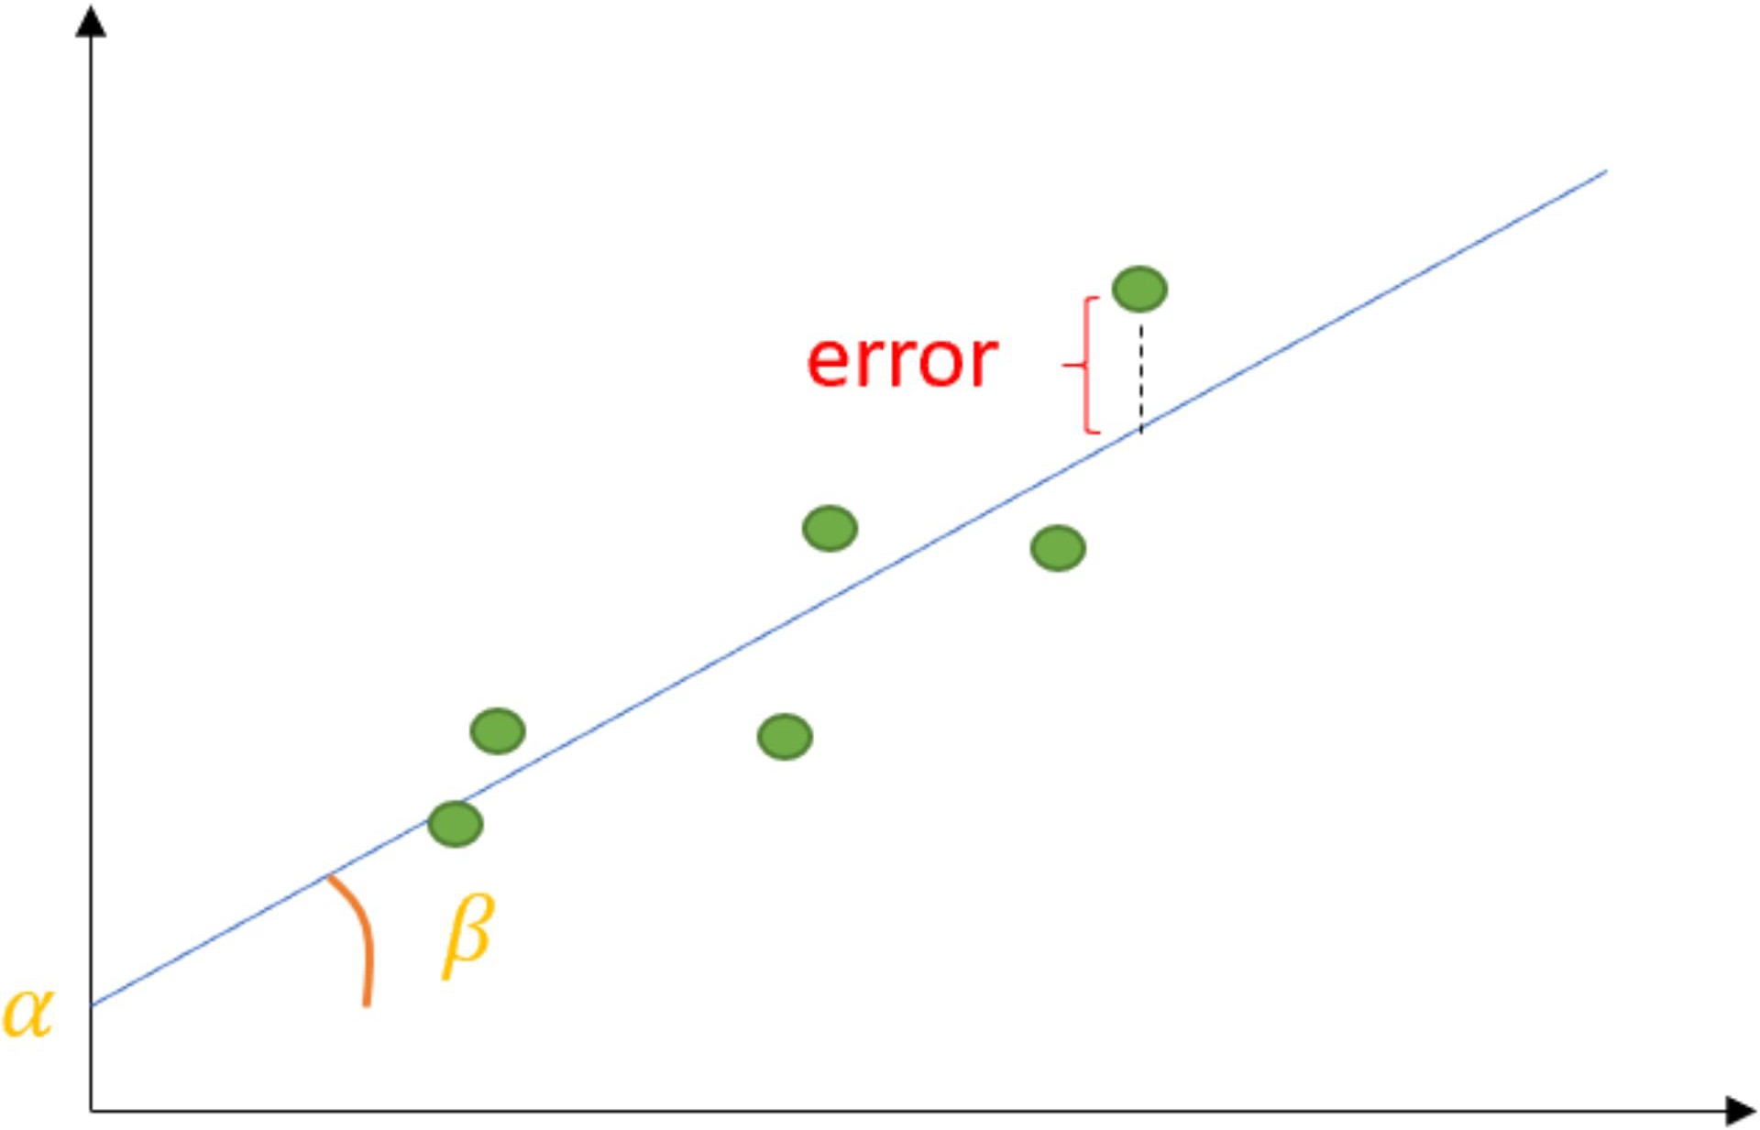
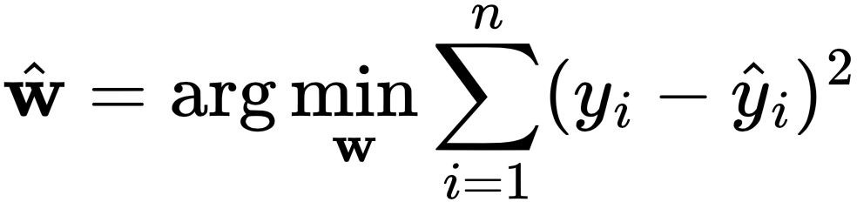
Training or Building Linear Regression
Training or Building Linear Regression means finding the parameters of the model (aka the weight vector) such that the MSE is minimize
Linear Regression models are relatively simple and is a very rare case where analytical solution exists
In more general cases, to train a model require using numerical methods (such as Gradient Descent) to perform minimizing of a certain cost function such as the above MSE
w₀

Slide 13
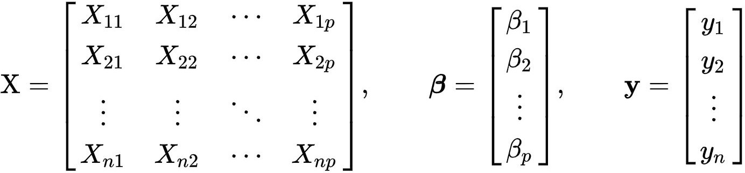
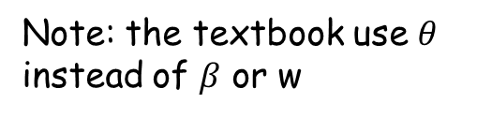
Analytical Solution
X𝝱=Y
X^{T}X𝝱=X^{T}Y
𝝱=(X^{T}X)⁻¹X^{T}Y
Note: the textbook use $θ$
instead of $β$ or w

Slide 14
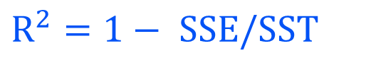
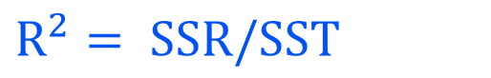
R-square as metrics for determining “goodness” of the fit
Determining the relationship between predictor & outcome
Relationship Among SST, SSR, SSE
SST = SSR + SSE
Higher R-square => Lower SSE => Better Model
R-square is 0% to 100%, anything > 70% is great
where:
SST = total sum of squares
SSR = sum of squares due to regression
SSE = sum of squares due to error
Define
$R^{2}= SSR/SST$
Then
$R^{2}=1− SSE/SST$
statistics - Prove $SST=SSE+SSR$ - Mathematics Stack Exchange

Slide 15
Common Theme, Toolbox and Research workflow in Data Science
Apply different algorithms to solve different problems
based on the same theme and research workflow
Algorithms
SVM
KNN
Naïve Bayes
Neural Network
Logistics Regression
NLP
Problems
Regression
Classification
Recommendation System
Clustering
Association
Theme
Research Workflow
Toolbox

Slide 16
Common Theme, Toolbox and Research workflow in Data Science
Will use Linear Regression for many of the general practices in building models, some of them are
Split the dataset into training set and a testing set
Use standard metrics to judge model performance
K-fold cross validation

Slide 17
Linear Regression
Learning by doing

Slide 18
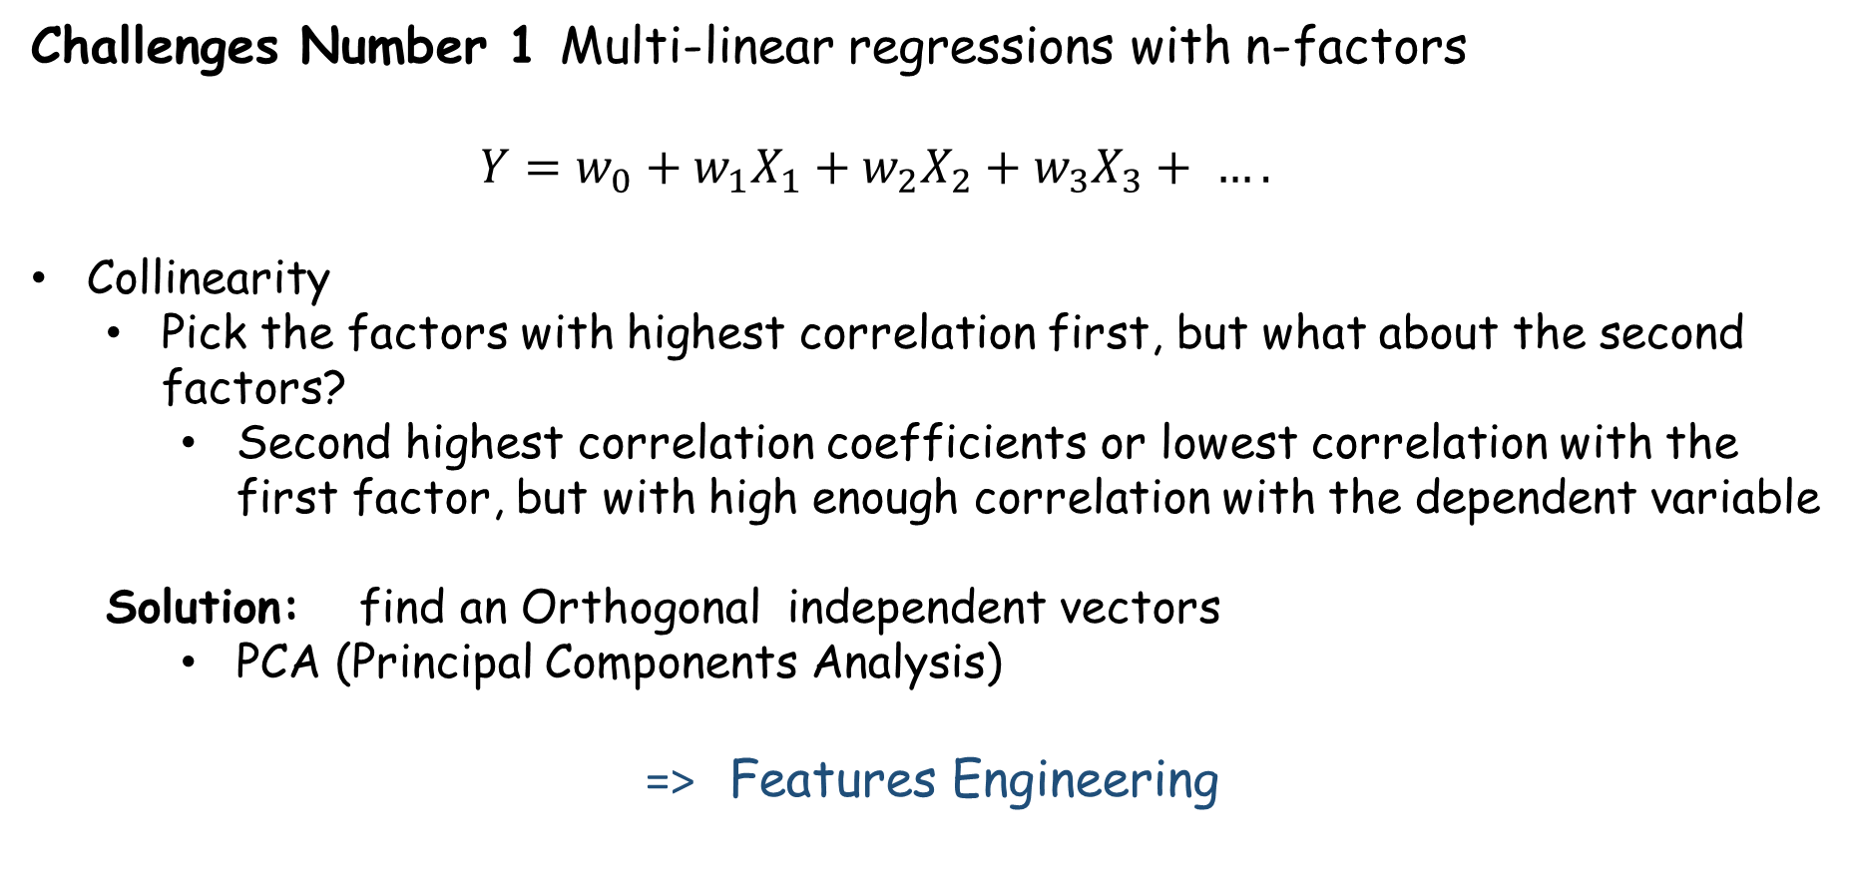
Linear Regression Continued
Challenges Number 1 Multi-linear regressions with n-factors
$Y=w_{0}+w_{1}X_{1}+w_{2}X_{2}+w_{3}X_{3}+ ….$
Collinearity
Pick the factors with highest correlation first, but what about the second factors?
Second highest correlation coefficients or lowest correlation with the first factor, but with high enough correlation with the dependent variable
Solution: find an Orthogonal independent vectors
PCA (Principal Components Analysis)
=> Features Engineering

Slide 19
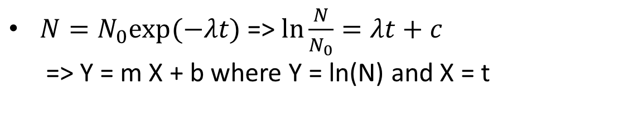
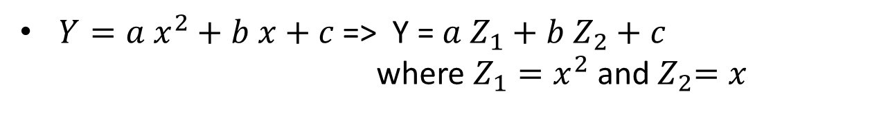
Linear Regression
Challenge Number 2:
Relationship is NOT linear
Solution: Transform non-linear relationship into linear equations
Example:
$Y=a x^{2}+b x+c$=> Y = $a Z_{1}+b Z_{2}+c$
where $Z_{1}=x^{2}$ and${ Z}_{2}=x$
$N=N_{0}exp⁡(−λt)$ => $\ln{\frac{N}{N_{0}}=λt+c}$
=> Y = m X + b where Y = ln(N) and X = t

Slide 20
Polynomial Regression
Learning by doing

Slide 21
Simple vs More complicated model
Using a model with more parameters (more features, more independent variables), you are guaranteed to fit your in-sample data (training data) better
More parameters => R-squares always increases
BUT it doesn’t mean you have a better model
Adjusted R-squares ( R-squares adjusted by penalizing models with more parameters)

Slide 22
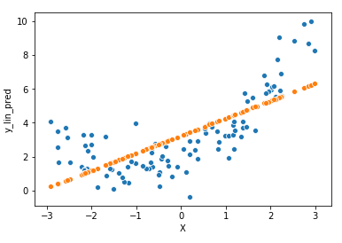
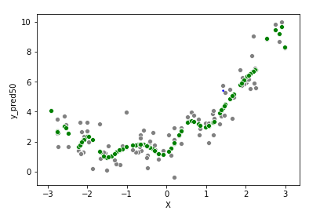
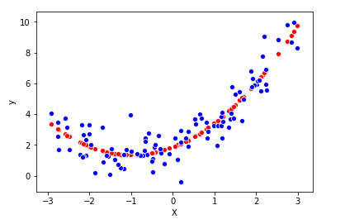
Lessons Learned from Polynomial Regression
Underfit
Overfit
Good fit
A more sophisticated model tends to have smaller errors in the training set, but can perform worse in testing dataset because it overfit
A too simplistic model will never be able to fit well on both the training set as well as the testing dataset

Slide 23
Bias vs Variance
Bias means your model is intrinsically wrong (off, biased) that you will not fit the data well. If you use a too simplistic model, you will have high bias.
On the other hand, using a more complicated model, you will have low bias. However, your model will not generalize well to testing dataset (out-of-sample data). The “variance” of your prediction will be high
We call this the Bias vs Variance trade-off

Slide 24
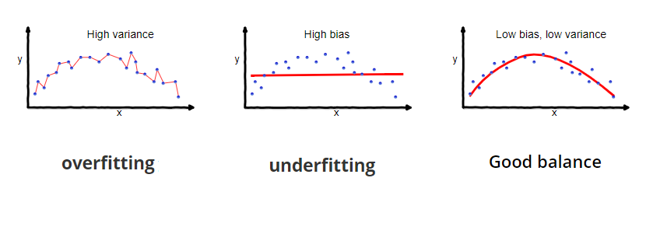
Bias vs Variance Tradeoff

Slide 25
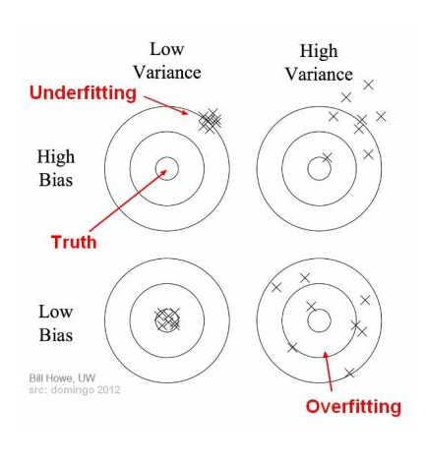
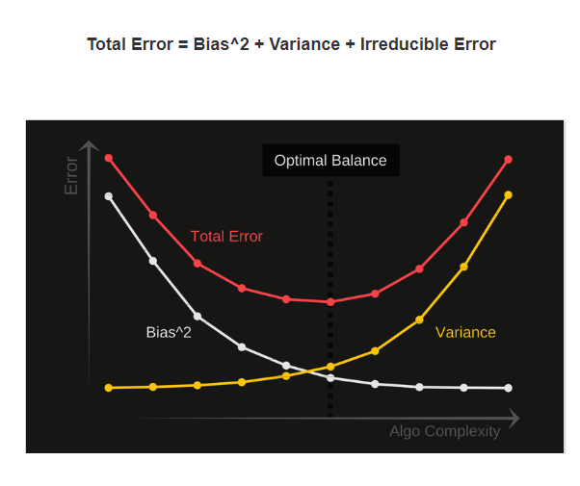
Bias vs Variance Tradeoff

Slide 26
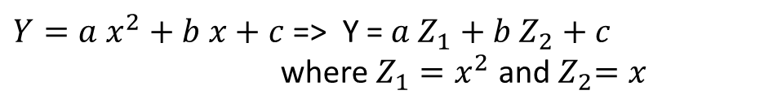
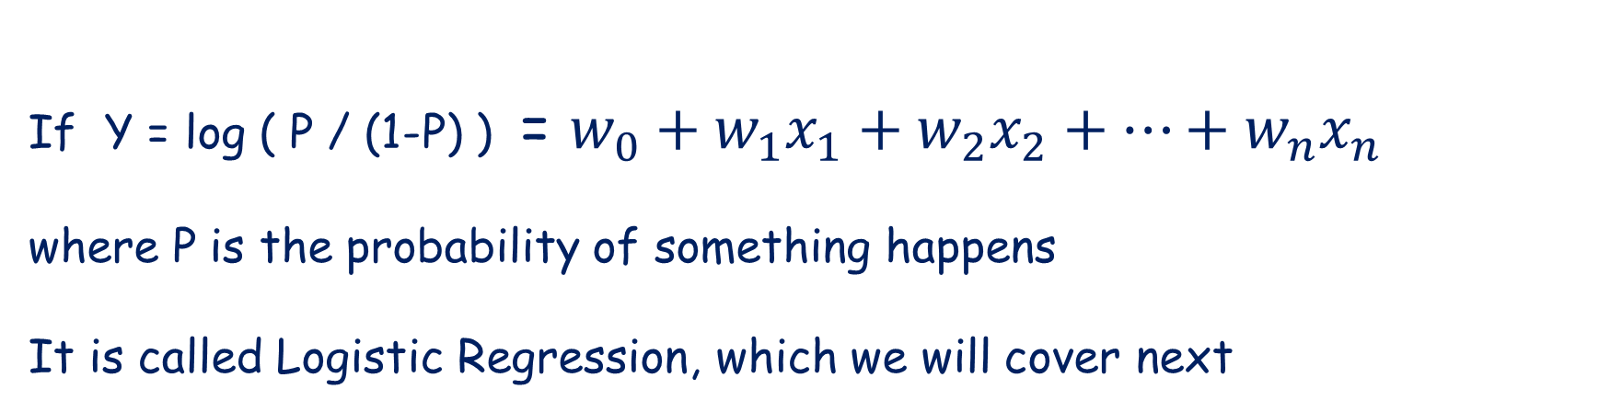
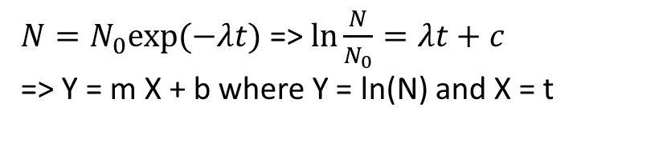
Recall Linear Regression can still apply to non-linear relationship
$Y=a x^{2}+b x+c$=> Y = $a Z_{1}+b Z_{2}+c$
where $Z_{1}=x^{2}$ and${ Z}_{2}=x$
$N=N_{0}exp⁡(−λt)$ => $\ln{\frac{N}{N_{0}}=λt+c}$
=> Y = m X + b where Y = ln(N) and X = t
If Y = log ( P / (1-P) ) = $w_{0}+w_{1}x_{1}+w_{2}x_{2}+…+w_{n}x_{n}$
where P is the probability of something happens
It is called Logistic Regression, which we will cover next

Slide 27
Classification Problem
Linear Regression: Target variable can take any numeric value
Binary Classification Problem: Target variable is either 1 or 0, Yes or No
Multi-class Classification Problem: Target variable is a list of possible values (such as classify a picture of animal as a cat, dog, bird, fish picture)

Slide 28
Outline
Linear Regression
Mean Square Error
Cost Function
R-squares
Train/test Split
K-fold cross validation
Polynomial Regression
Bias vs Variance
Common Problems
Logistics Regression
Classification Problem
Maximum Likelihood Principle
Cost Function
Precision/Recall as Performance metric

Slide 29
Classification Problem
A classification problem is a problem where the goal is to predict whether the target variable belongs to one of the pre-defined possibilities. When there are only two choices, it is referred to as a binary classification problem. Otherwise, it is a multi-class classification problem
Example:
Wining or Losing a game
Determine whether an email is a spam or not
Decide whether it will rain or not tomorrow
Although the final forecast target variable is either 1 or 0 (Win or Lose, Spam or not Spam, Rain or not rain), we often forecast the probability of the interested event first. If the probability is larger than 0.5, we classify the instance as “1”, otherwise as “0”

Slide 30
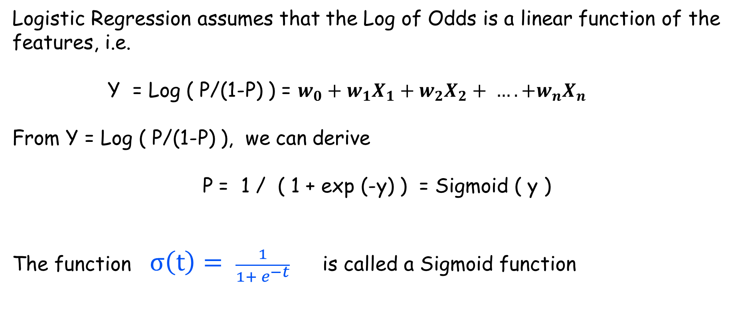
Logistic Regression
Logistic Regression assumes that the Log of Odds is a linear function of the features, i.e.
Y = Log ( P/(1-P) ) = $w_{0}+w_{1}X_{1}+w_{2}X_{2}+ …. +w_{n}X_{n}$
From Y = Log ( P/(1-P) ), we can derive
P = 1 / ( 1 + exp (-y) ) = Sigmoid ( y )
The function $σ\left(t\right)= \frac{1}{1+ e^{−t}}$ is called a Sigmoid function

Slide 31
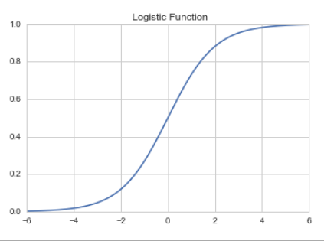
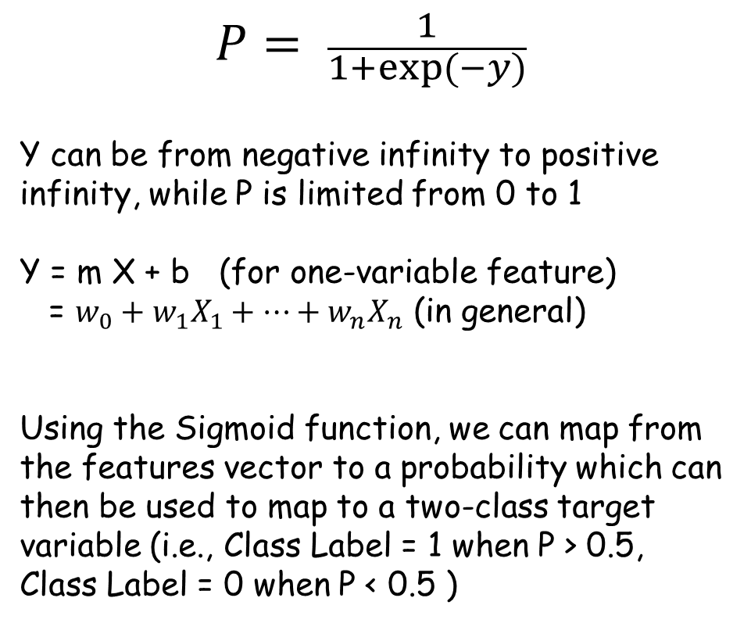
Characteristic of a Sigmoid Function
$$P= \frac{1}{1+exp⁡(−y)}$$
Y can be from negative infinity to positive infinity, while P is limited from 0 to 1
Y = m X + b (for one-variable feature)
= $w_{0}+w_{1}X_{1}+…+w_{n}X_{n}$ (in general)
Using the Sigmoid function, we can map from the features vector to a probability which can then be used to map to a two-class target variable (i.e., Class Label = 1 when P > 0.5, Class Label = 0 when P < 0.5 )
P
Y

Slide 32
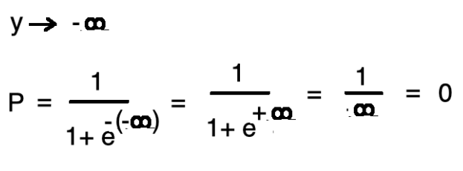
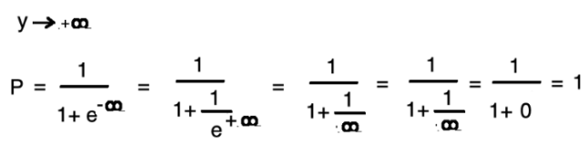
Sigmoid Function (aka logistic function)
Now consider an example where we want to decide whether a student pass or fail based on how many hours he studies before the test
Class Label = 1 or 0 = Pass or Fail
Predictor = Number of hours studied
One can solve this as a Logistic Regression with one variable
Log ( P/(1-P) ) = Y = m X + b
m and b are the regression coefficients
X is the number of hours studies
Y is the Log (Odds of Passing)
https://towardsdatascience.com/logistic-regression-python-7c451928efee

Slide 33
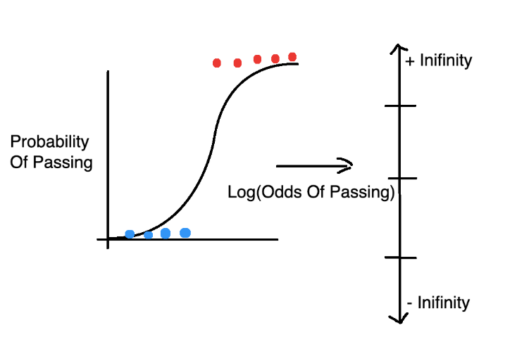
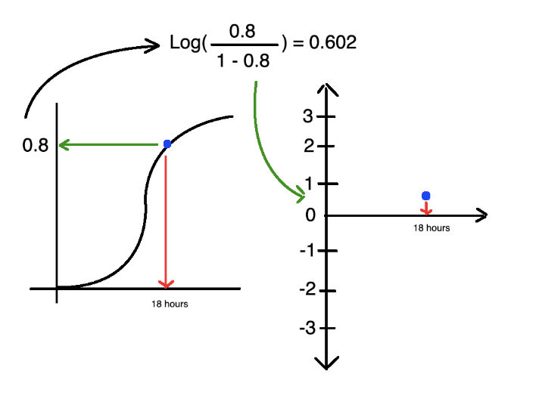
Transform between Probability space to the features space
# of hours studied

Slide 34
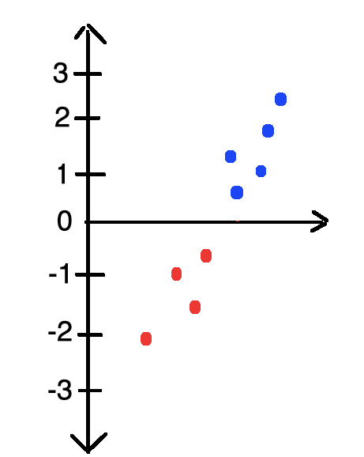
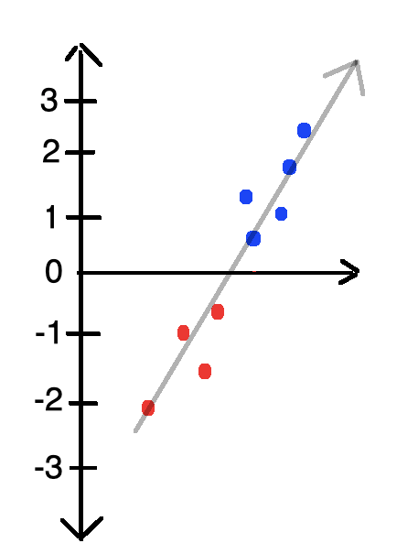
Repeat for each data points

Slide 35
Repeat for each data points

Slide 36
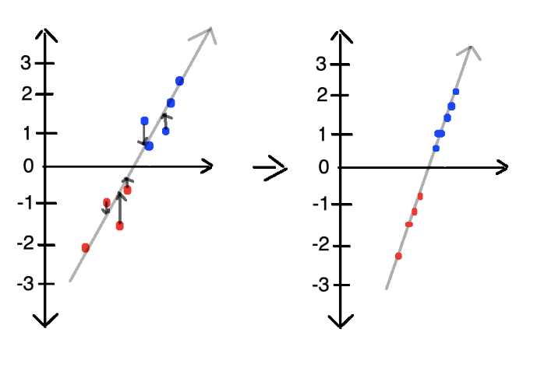
Now try to use Least Square to fit a line

Slide 37
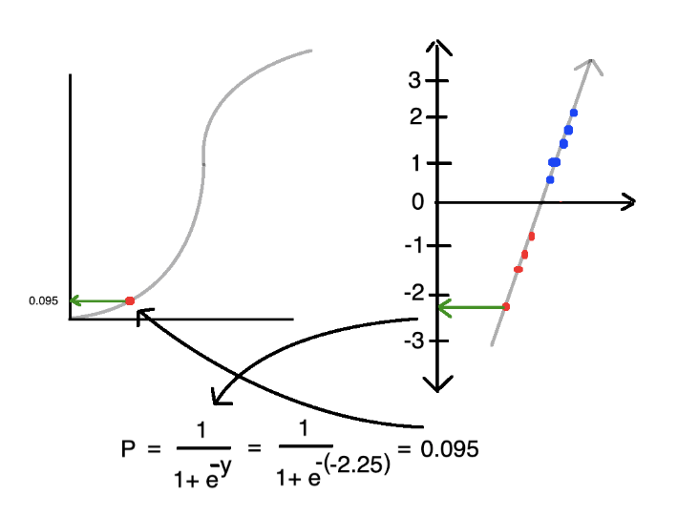
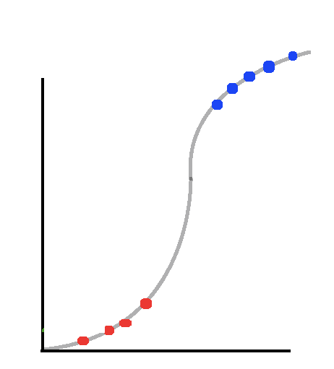
We can transform from the feature space back to the Probability space

Slide 38
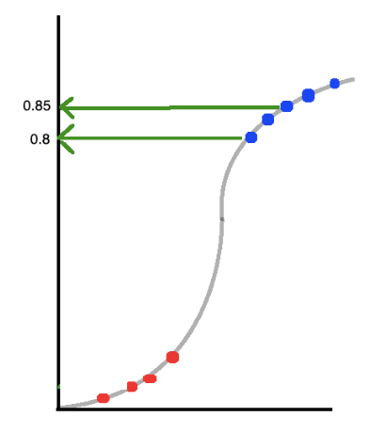
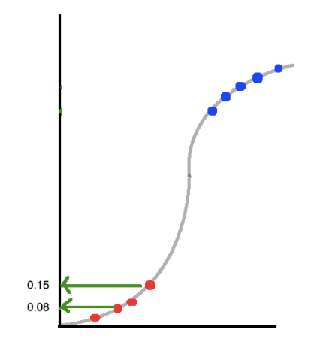
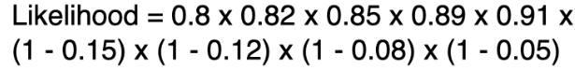
Now we have the data point on the Sigmoid curve

Slide 39
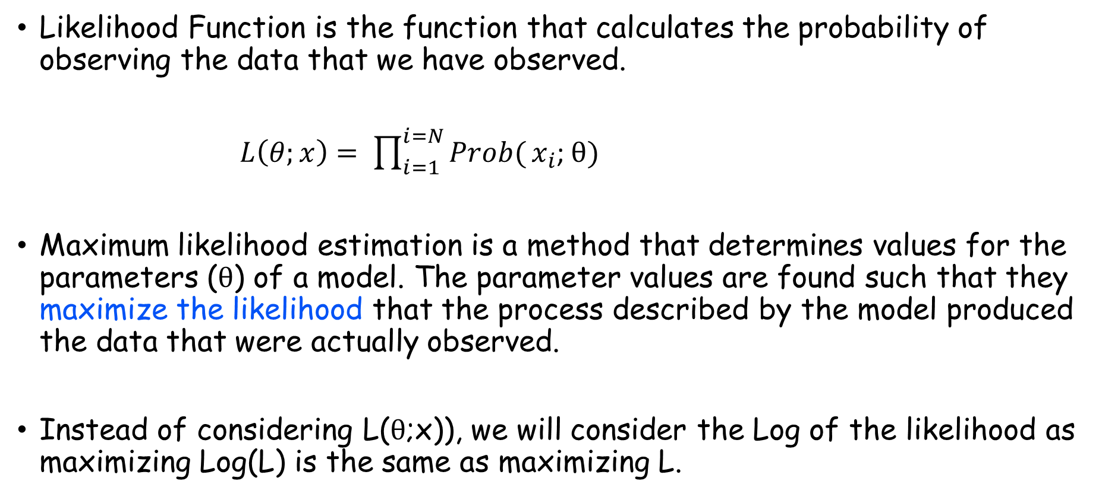
Likelihood Function
Likelihood Function is the function that calculates the probability of observing the data that we have observed.
$L\left(θ;x\right)= \prod_{i=1}^{i=N}{Prob(}x_{i}$; $θ)$
Maximum likelihood estimation is a method that determines values for the parameters ($θ$) of a model. The parameter values are found such that they maximize the likelihood that the process described by the model produced the data that were actually observed.
Instead of considering L($θ$;x)), we will consider the Log of the likelihood as maximizing Log(L) is the same as maximizing L.

Slide 40
Criteria for finding model parameters
Logistic Regression
Maximizing the Log Likelihood Function which is the same as minimizing the negative of the Log Likelihood Function
Linear Regression
Minimizing MSE
Can we express the criteria (methodology) for finding best-fitted line under the same “framework”?

Slide 41
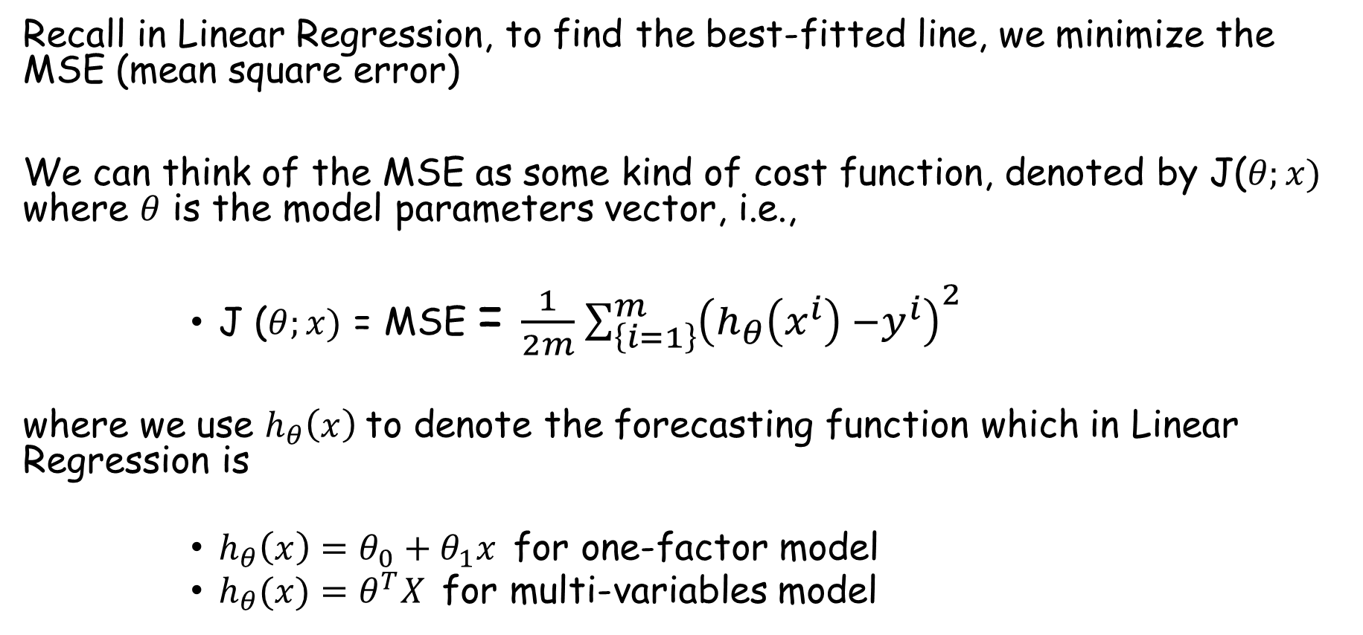
Concept of cost function
Recall in Linear Regression, to find the best-fitted line, we minimize the MSE (mean square error)
We can think of the MSE as some kind of cost function, denoted by J($θ;x)$ where $θ$ is the model parameters vector, i.e.,
J ($θ;x)$ = MSE = $\frac{1}{2m}\sum_{\left\{i=1\right\}}^{m}{{\left(h_{θ}\left(x^{i}\right) −y^{i}\right)}^{2}}$
where we use $h_{θ}\left(x\right)$to denote the forecasting function which in Linear Regression is
$h_{θ}\left(x\right)=θ_{0}+θ_{1}x$for one-factor model
$h_{θ}(x)=θ^{T}X$for multi-variables model

Slide 42
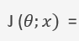
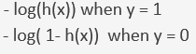
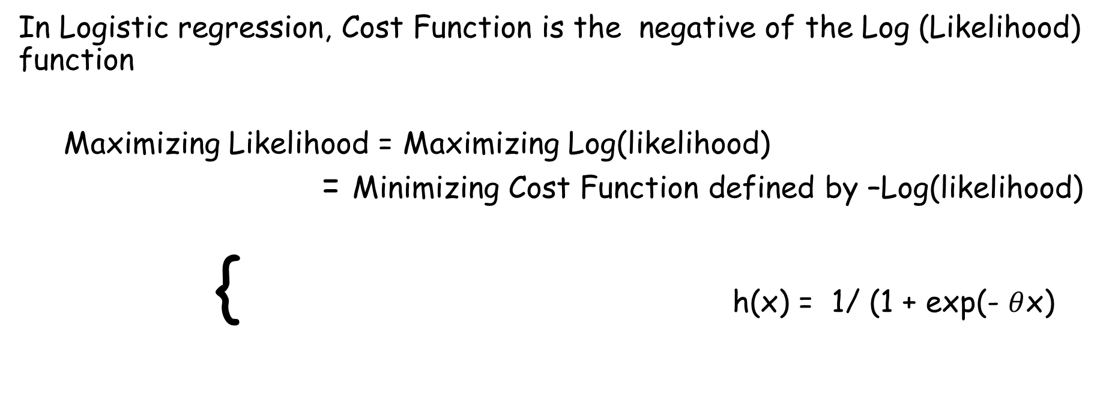
Cost Function in Logistic Regression
In Logistic regression, Cost Function is the negative of the Log (Likelihood) function
Maximizing Likelihood = Maximizing Log(likelihood)
= Minimizing Cost Function defined by –Log(likelihood)
{ h(x) = 1/ (1 + exp(- $θ$x)

Slide 43
Why this cost function makes sense
{
{
When Y = 1 (actual case), if forecast is wrong (ie forecast zero probability), i.e. h(x) => 0
then – log (h(x)) => big => Cost function is big
When Y = 0 (actual case), if forecast is wrong (ie forecast probability of one), i.e. h(x) => 1, ie. 1 – h(x) => 0
then – log (1 - h(x)) => big => Cost function is big
So, the cost function is big when the forecast is different from actual case
Therefore, minimizing cost function => forecasting the right answer

Slide 44
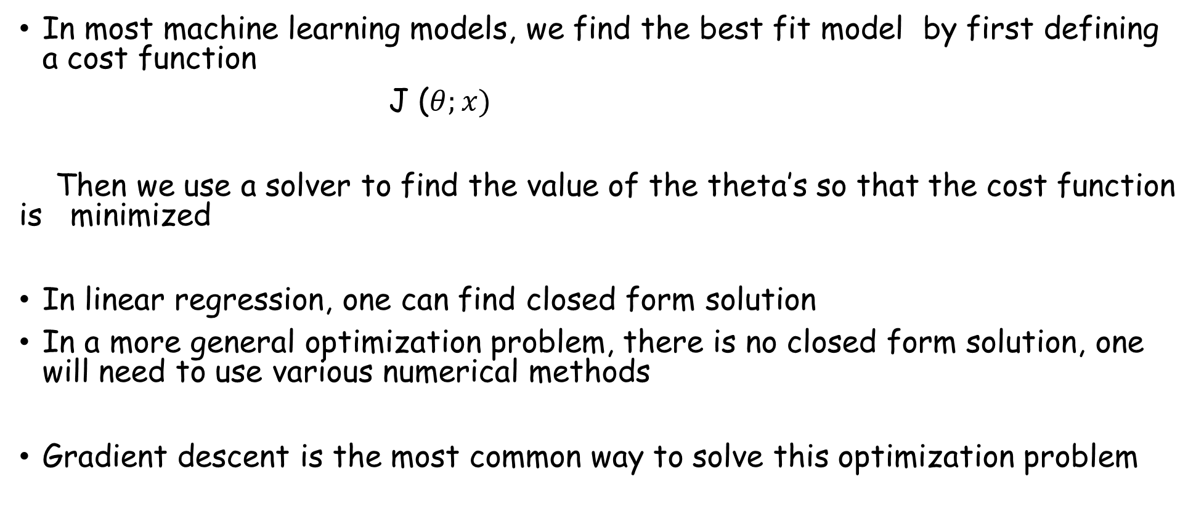
Optimization problem
In most machine learning models, we find the best fit model by first defining a cost function
J ($θ;x)$
Then we use a solver to find the value of the theta’s so that the cost function is minimized
In linear regression, one can find closed form solution
In a more general optimization problem, there is no closed form solution, one will need to use various numerical methods
Gradient descent is the most common way to solve this optimization problem

Slide 45




Gradient Descent in Linear Regression
In practice, we just call the “Fit” method from the library
https://medium.com/@lachlanmiller_52885/machine-learning-week-1-cost-function-gradient-descent-and-univariate-linear-regression-8f5fe69815fd

Slide 46
Andrew Ng’s old but popular Machine Learning videos
Andrew Ng’s popular Machine Learning class video is on
(3757) Machine Learning Specialization by Andrew Ng – YouTube
Focus on Gradient Descent in lectures 15
#11 Machine Learning Specialization [Course 1, Week 1, Lesson 3] (youtube.com) (Cost Function)
#12 Machine Learning Specialization [Course 1, Week 1, Lesson 3] (youtube.com)
#15 Machine Learning Specialization [Course 1, Week 1, Lesson 4] (youtube.com)
#16 Machine Learning Specialization [Course 1, Week 1, Lesson 4] (youtube.com)
#17 Machine Learning Specialization [Course 1, Week 1, Lesson 4] (youtube.com)

Slide 47

Cost Function in 2-dimension
(3757) #13 Machine Learning Specialization [Course 1, Week 1, Lesson 3] - YouTube

Slide 48

Visualization of Gradient Descent

Slide 49


Gradient Descent for “training” a model
(3757) #15 Machine Learning Specialization

Slide 50

Gradient Descent Intuition

Slide 51

Common Terminology in Machine Learning
How many you know

Slide 52

Type I and Type II error
Positive case is the case you are interested and usually encoded as 1.
Negative case is the case you are not interested and usually is encoded as 0
Type I error when you have a False Positive (FP) case
Example:
Actual case is losing (0), but you predict winning (1)
Actual case is not default (0), but you predict he/she will default (1)
Type II error when you have a False Negative (FN) case
Example:
Actual case is winning (1), but you predict losing (0)
Actual case is the loan will not be paid off (ie default, 1), you predict that the loan will be paid off

Slide 53





Model Performance (All models are wrong, but some are useful)
Confusion Matrix
Out of the ones you claims positives, how many are correct.
To increase Precision, you try to be conservative in claiming positive case, but you risk missing out
Precision
Out of the correct positives, how many you pick up in your prediction. Also, known as Sensitivity
To increase Recall, try to predict positive even though the evidence is not strong, but you risk increase false positive rate
Recall
We want both Precision and Recall to be high > 80%, but there is a trade-off
F1-score is a one single metric to combine both Precision and Recall
https://medium.com/analytics-vidhya/accuracy-vs-f1-score-6258237beca2

Slide 54

Model Performance metrics
Accuracy is only good when the both possible outcomes are similar. For example, in the 5% are spam, the accuracy that just spam email case, say only predict no spam will have of a model an accuracy of 95%!!! This is called Accuracy Paradox
Precision and Recall are two addition metrics. F1 score is a harmonic mean of Precision and Recall to combine the two scores into one score
TPR = TP / ( TP + FN ) = Recall = true positive rate
FPR = FP / ( FP + TN) = out of all negatives, how many you mis-classify = false positive rate
ROC Curve (receiver operating characteristic curve) is a graph showing the performance of a classification model at different classification thresholds
AUC (Area Under the ROC Curve) measures the 2-dimensional area underneath the entire ROC curve
ROC Curve / AUC Score
Green line is a random model
Orange line model is a better model than the blue line model

Slide 55
Logistics Regression
Learning by doing
https://medium.com/towards-data-science/an-introduction-to-the-magic-of-machine-learning-6b213e88b54c

Slide 56
Outline
Linear Regression
Mean Square Error
Cost Function
R-squares
Train/test Split
K-fold cross validation
Polynomial Regression
Bias vs Variance
Common Problems
Logistics Regression
Classification Problem
Maximum Likelihood Principle
Cost Function
Precision/Recall as Performance metric
Multi-Class Classification Problem

Slide 57

Multi-class Logistic Regression

Slide 58
Multi-class Logistic Regression
X₁ | X₂ | X₃ | … | ^{X}D-1 | X_{D} | Y
0.23 | 0.79 | 0.33 | … | -2.4 | 0.91 | dog
 |  |  | … |  |  | …
-0.34 | 0.44 | -0.32 | … | 0.11 | 0.007 | cat
0.40 | -0.68 | 0.82 | … | -0.45 | 0.004 | elephant

Slide 59
Multi-class Logistic Regression
Basic idea:
find K scoring function: s₁, s₂, … s_{k}
classify x to class y = argmax_{i} s_{i}(x)

Slide 60




Multi-class Logistic Regression
Get a scalar in linear regression:
Convert scalar to probability in binary logistic regression:
Softmax function
Convert scalar to probability in
K-class logistic regression:

Slide 61
Multi-class Logistic Regression
X: each data point has D features, then X is N⨉D
W: each class has a weight vector of length D, then W
is a weight matrix of size K⨉D

Slide 62


Multi-class Logistic Regression

Slide 63


Multi-class Logistic Regression
Model computes:
In matrix multiplication notation:

Slide 64

Example: 3-class Logistic Regression with 3 inputs

